Slide 1
Engineering Management
Decision Making
Lecture 13,14,15

Slide 2
Objectives
Discuss how decision making relates to planning.
Explain the process of engineering problem solving.
Solve problems using three types of decision-making tools.
Discuss the differences between decision making under certainty, risk, and uncertainty.
Describe the basics of other decision-making techniques.

Slide 3
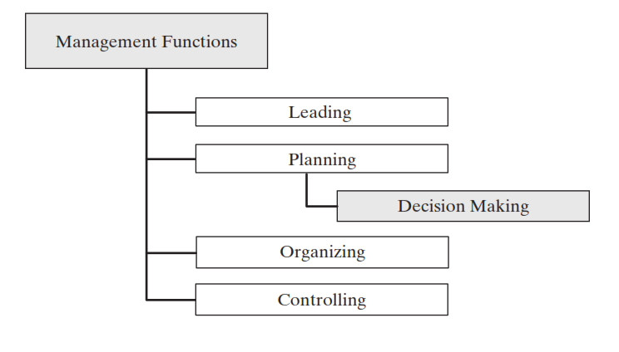
Decision Making
Decision making is an essential part of planning. Decision making and problem solving are used in all management functions, although usually they are considered a part of the planning phase.

Slide 4
Nature of Decision Making
Relation to Planning
Occasions for Decision

Slide 5
Types of Decisions
Routine and Non routine Decisions.
Classify decisions on a continuum ranging from routine to non routine, depending on the extent to which they are structured. They describe routine decisions as focusing on well-structured situations that recur frequently, involve standard decision procedures, and entail a minimum of uncertainty.
Common examples include payroll processing, reordering standard inventory items, paying suppliers, and so on. The decision maker can usually rely on policies, rules, past precedents, standardized methods of processing, or computational techniques.
Probably 90 percent of management decisions are largely routine.

Slide 6
Types of Decisions
Objective versus bounded rationality.
Simon defines a decision as being objectively rational if in fact it is the correct behavior for maximizing given values in a given situation. Such rational decisions are made
(a) by viewing the behavior alternatives prior to decision in panoramic fashion.
(b) by considering the whole complex of consequences that would follow on each choice.
(c) with the system of values as criterion singling out one from the whole set of alternatives.”
Rational decision making, therefore, consists of optimizing, or maximizing, the outcome by choosing the single best alternative from among all possible ones

Slide 7
Types of Decisions
Level of certainty.
Decisions may also be classified as being made under conditions of certainty, risk, or uncertainty, depending on the degree with which the future environment determining the outcome of these decisions is known.

Slide 8
Management science
Management science has been defined as having the following “primary distinguishing characteristics”:
1. A systems view of the problem—a viewpoint is taken that includes all of the significant interrelated variables contained in the problem.
2. The team approach—personnel with heterogeneous backgrounds and training work together on specific problems.
3. An emphasis on the use of formal mathematical models and statistical and quantitative techniques.

Slide 9
Management science
Management science uses a five-step process that begins in the real world, moves into the model world to solve the problem, and then returns to the real world for implementation. The following explanation is, in itself, a conceptional model of a more complex process:
Real World
Formulate the problem (defining objectives, variables, and constraints).
Simulated Model
2. Construct a mathematical model (a simplified yet realistic representation of the system).
3. Test the model’s ability to predict the present from the past, and revise until you are satisfied.
4. Derive a solution from the model.
Real World
5. Apply the model’s solution to the real system, document its effectiveness, and revise further as required.

Slide 10
Tools for decision making
Linear Programming.
One common technique for decision making under certainty is called linear programming. In this method, a desired benefit (such as profit) can be expressed as a mathematical function (the value model or objective function) of several variables. The solution is the set of values for the independent variables (decision variables) that serves to maximize the benefit (or, in many problems, to minimize the cost), subject to certain limits (constraints). Steps include:
• State the problem.
• What are the decision variables?
• Objective function
• Constraints

Slide 11
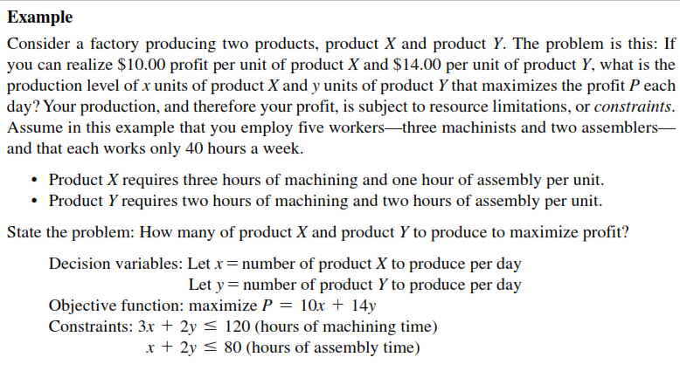

Slide 12
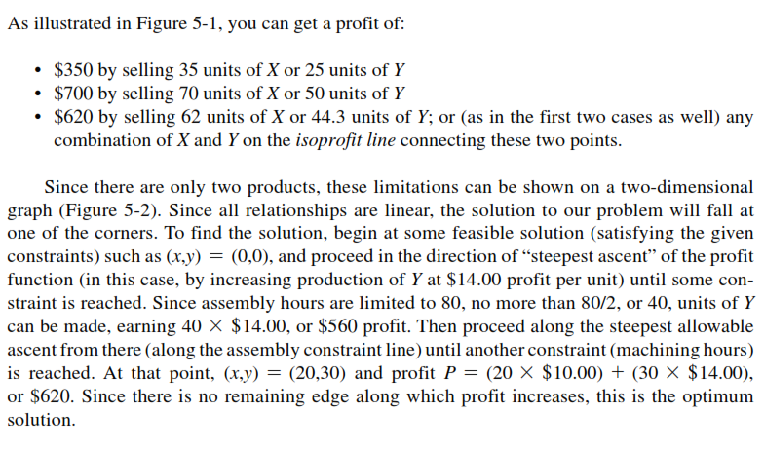

Slide 13
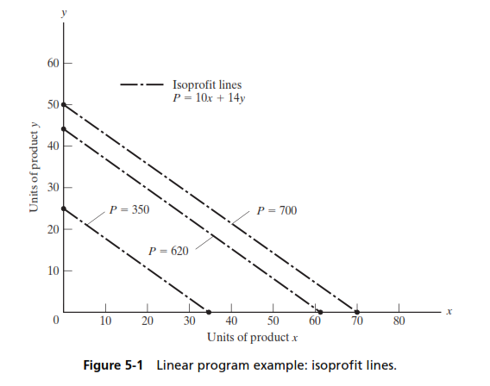

Slide 14
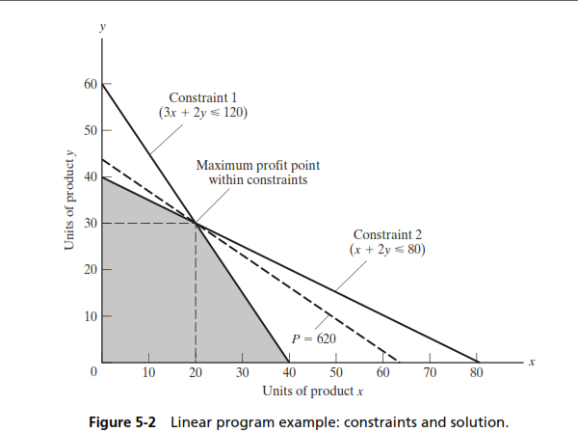

Slide 15
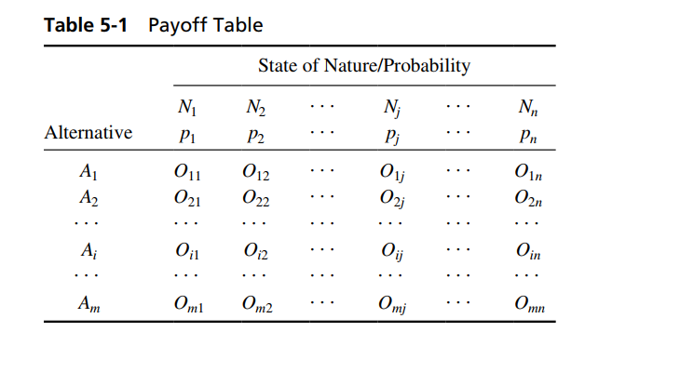
Payoff table

Slide 16
Decision Making under risk
Nature of risk. In decision making under risk one assumes that there exist a number of possible future states of nature Nj, as we saw in Table. Each Nj has a known (or assumed) probability pj of occurring, and there may not be one future state that results in the best outcome for all alternatives Ai. Examples of future states and their probabilities are as follows:
• Alternative weather (N1 = rain; N2 = good weather) will affect the profitability of alternative construction schedules; here, the probabilities p1 of rain and p2 of good weather can be estimated from historical data.
• Alternative economic futures (boom or bust) determine the relative profitability of conservative versus high-risk investment strategy; here, the assumed probabilities of different economic futures might be based on the judgment of a panel of economists.

Slide 17
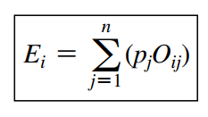
Decision Making under risk
Expected value. Given the future states of nature and their probabilities, the solution in decision making under risk is the alternative Ai that provides the highest expected value Ei, which is defined as the sum of the products of each outcome Oij times the probability pj that the associated state of nature Nj occurs:

Slide 18
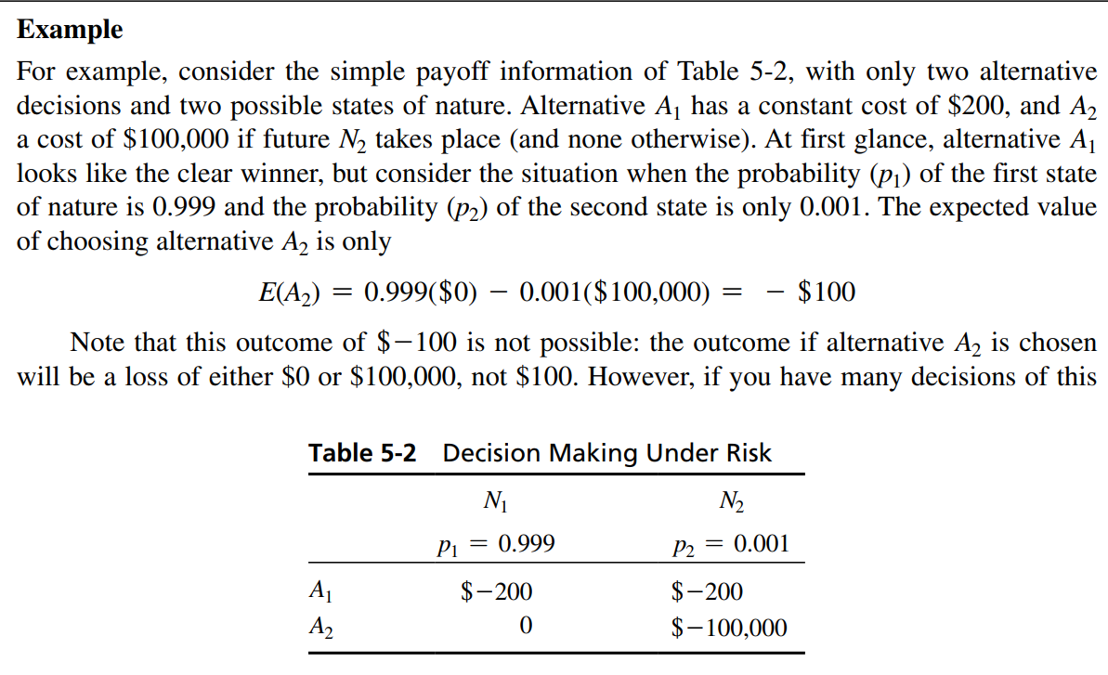

Slide 19
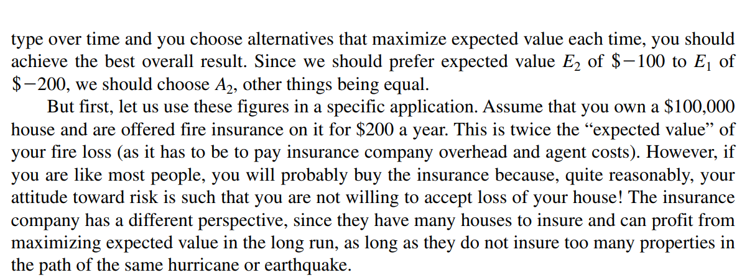

Slide 20
Decision Making under uncertainty
At times, a decision maker cannot assess the probability of occurrence for the various states of nature. Uncertainty occurs when there exist several (i.e., more than one) future states of nature Nj, but the probabilities pj of each of these states occurring are not known. In such situations the decision maker can choose among several possible approaches for making the decision.
A different kind of logic is used here, based on attitudes toward risk. Different approaches to decision making under uncertainty include the following:
• The optimistic decision maker may choose the alternative that offers the highest possible outcome (the “maximax” solution).
• The pessimist decision maker may choose the alternative whose worst outcome is “least bad”(the “maximin” solution).
• The third decision maker may choose a position somewhere between optimism and pessimism (“Hurwicz” approach).

Slide 21
Decision Making under uncertainty
• Another decision maker may simply assume that all states of nature are equally likely (the so-called “principle of insufficient reason”), set all pj values equal to 1.0/n, and maximize expected value based on that assumption.
• The fifth decision maker may choose the alternative that has the smallest difference between the best and worst outcomes (the “minimax regret” solution). Regret here is understood as proportional to the difference between what we actually get, and the better position that we could have received if a different course of action had been chosen. Regret is sometimes also called “opportunity loss.” The minimax regret rule captures the behavior of individuals who spend their post-decision time regretting their choices.

